Slide 1

A Risk-based approach for assessing R package accuracy within a validated infrastructure
Juliane Manitz, EMD Serono; Andy Nicholls, GSK; Paulo Bargo, Janssen R&D; Doug Kelkhoff, Roche; Yilong Zhang, Merck & Co., Inc.; Lyn Taylor , Phastar; Joe Rickert, R Consortium; Marly Gotti, Biogen; Keaven M Andersen, Merck & Co. Inc.

Slide 2

How do I validate R?

Slide 3
Is my software reliable?

Slide 4
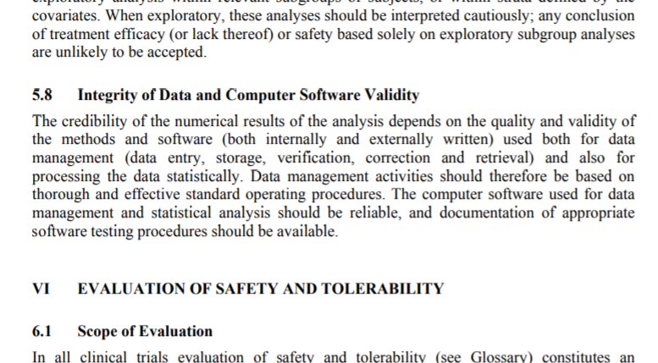
Reliable Software
5.8 Integrity of Data and Computer Software Validity
The credibility of the numerical results of the analysis depends on the quality and validity of the methods and software (both internally and externally written) used both for data management (data entry, storage, verification, correction and retrieval) and also for processing the data statistically. Data management activities should therefore be based on thorough and effective standard operating procedures. The computer software used for data management and statistical analysis should be reliable, and documentation of appropriate software testing procedures should be available.
ICH E9: https://www.ema.europa.eu/en/documents/scientific-guideline/ich-e-9-statistical-principles-clinical-trials-step-5_en.pdf

Slide 5
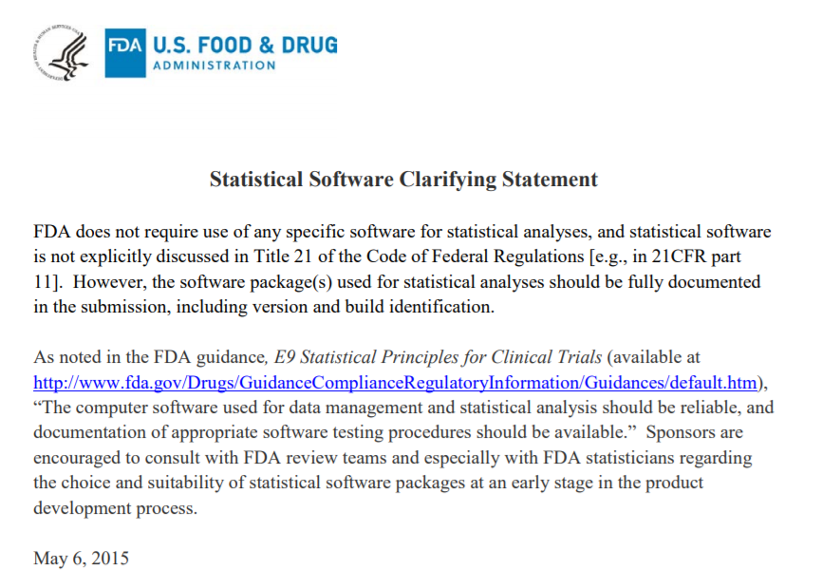
Source: https://www.fda.gov/downloads/ForIndustry/DataStandards/StudyDataStandards/UCM587506.pdf
Notes:
ICH: “… **should be reliable**, and documentation of **appropriate software testing procedures** should be available”
‘Validation’ isn’t actually mentioned.
Themes including ‘documentation’, ‘testing’ are emphasised.
Source: https://www.fda.gov/downloads/ForIndustry/DataStandards/StudyDataStandards/UCM587506.pdf

Slide 6
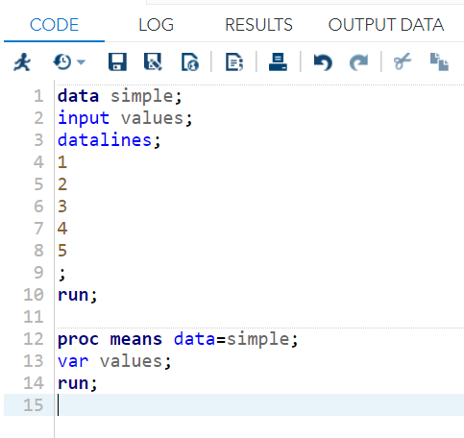
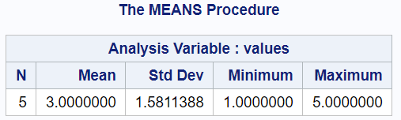
Example
Is this reliable?

Slide 7
Reliable Software
Why do we trust the summary?
“I know the actual answer”
“It’s in the ballpark of what I might expect to see”
“I’ve used the software before and it did what I expected”
“Many others use the software and it does what they expect”
“When I learnt statistics, I was taught using the software”
“The software is used/cited in statistical literature”
“I trust that the software owner develops it using best practice”
“The software owner provides tests that I can use to verify that it is working”
Intuition
Community Exposure
Developer SDLC
Notes:
Intuition only gets us so far. Difficult to explain to an auditor.
Community Exposure and SDLC are measurable.

Slide 8
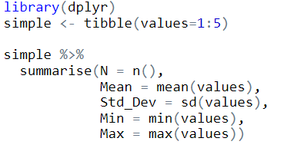
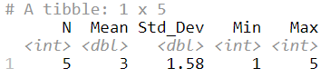
Example
Is this reliable?

Slide 9

Reliable Software
Why do we trust the summary?
“I know the actual answer”
“It’s in the ballpark of what I might expect to see”
“I’ve used the software before and it did what I expected”
“Many others use the software and it does what they expect”
“When I learnt statistics, I was taught using the software”
“The software is used/cited in statistical literature”
“I trust that the software owner develops it using best practice”
“The software owner provides tests that I can use to verify that it is working”
Intuition
Community Exposure
Developer SDLC
Notes:
Intuition only gets us so far. Difficult to explain to an auditor.
Community Exposure and SDLC are measurable.

Slide 10
Reliable Software
Why do we trust the summary?
“I know the actual answer”
“It’s in the ballpark of what I might expect to see”
“I’ve used the software before and it did what I expected”
“Many others use the software and it does what they expect”
“When I learnt statistics, I was taught using the software”
“The software is used/cited in statistical literature”
“I trust that the software owner develops it using best practice”
“The software owner provides tests that I can use to verify that it is working”
Intuition
Community Exposure
Developer SDLC
Notes:
Intuition only gets us so far. Difficult to explain to an auditor.
Community Exposure and SDLC are measurable.

Slide 11
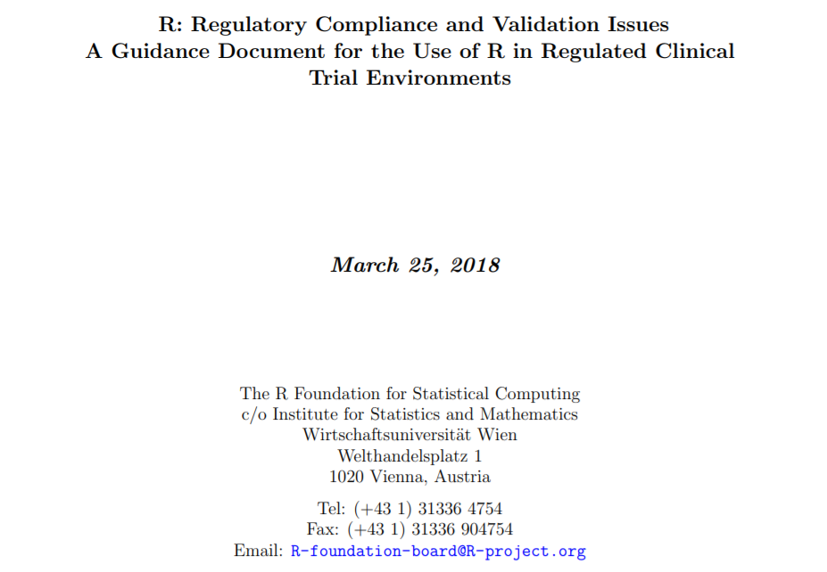
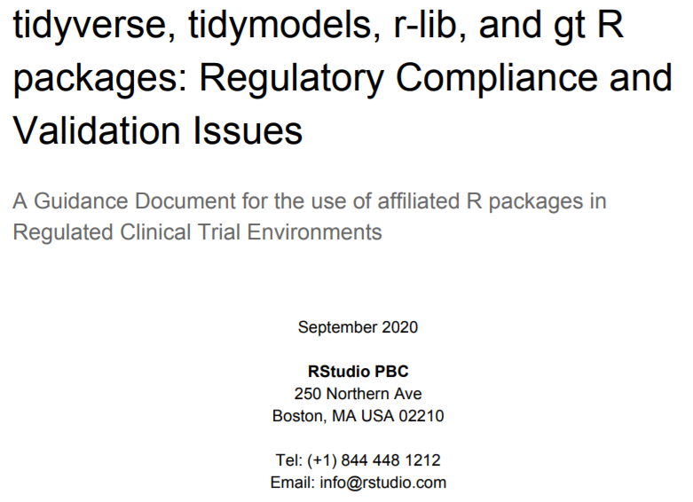
I trust that the software owner develops it using best practice
https://www.r-project.org/doc/R-FDA.pdf
https://resources.rstudio.com/assets/img/validation-tidy.pdf

Slide 12
Reliable Software
Why do we trust the summary?
“I know the actual answer”
“It’s in the ballpark of what I might expect to see”
“I’ve used the software before and it did what I expected”
“Many others use the software and it does what they expect”
“When I learnt statistics, I was taught using the software”
“The software is used/cited in statistical literature”
“I trust that the software owner develops it using best practice”
“The software owner provides tests that I can use to verify that it is working”
Intuition
Community Exposure
Developer SDLC
Notes:
Intuition only gets us so far. Difficult to explain to an auditor.
Community Exposure and SDLC are measurable.

Slide 13
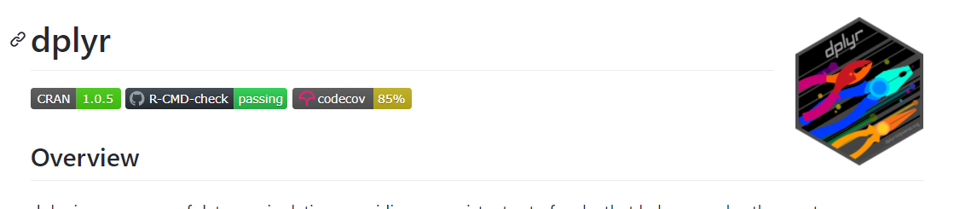
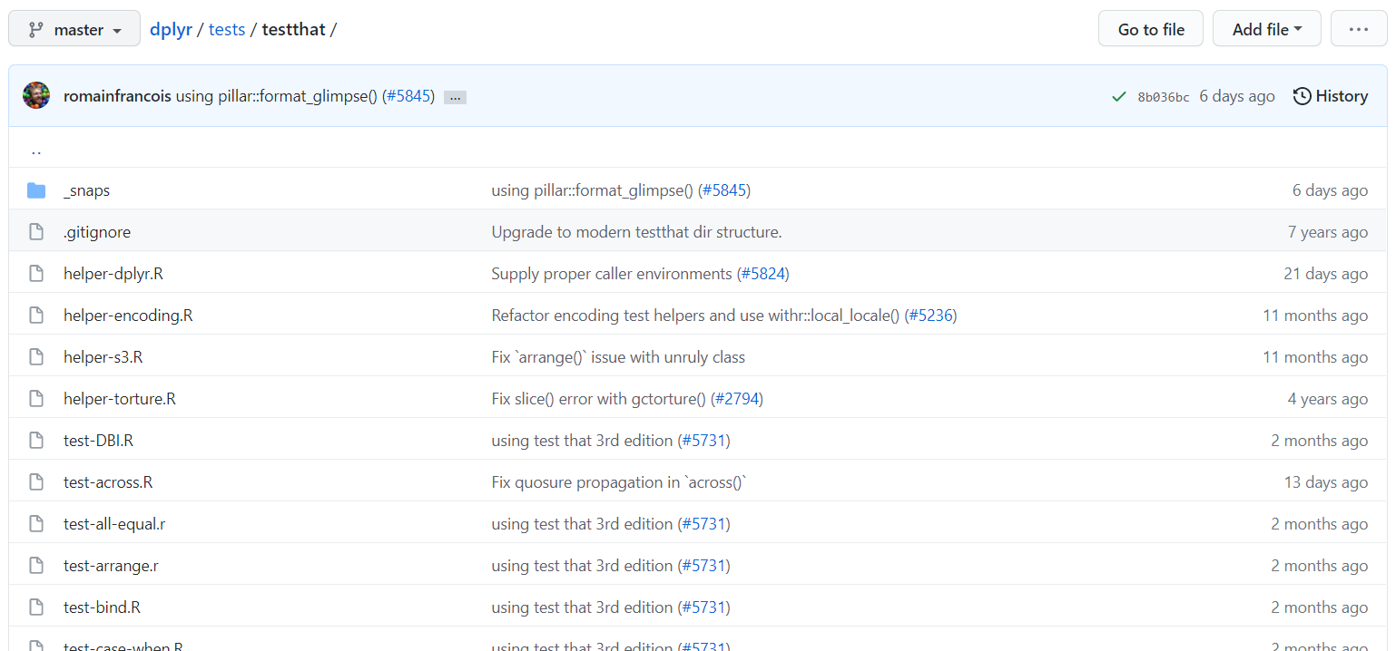

Slide 14
Reliable Software
Why do we trust the summary?
“I know the actual answer”
“It’s in the ballpark of what I might expect to see”
“I’ve used the software before and it did what I expected”
“Many others use the software and it does what they expect”
“When I learnt statistics, I was taught using the software”
“The software is used/cited in statistical literature”
“I trust that the software owner develops it using best practice”
“The software owner provides tests that I can use to verify that it is working”
Intuition
Community Exposure
Developer SDLC
Notes:
Intuition only gets us so far. Difficult to explain to an auditor.
Community Exposure and SDLC are measurable.

Slide 15
So why is it so difficult to use Open Source languages for GxP analyses?!

Slide 16
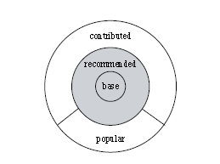
Challenge 1: The R Ecosystem
Core R (Base+Recommended) - Low risk
Contributed - Variable risk
Many different authors
Varying SDLCs
Varying levels of popularity
Potentially lots of unknowns
Image source: German, D.M. & Adams, Bram & Hassan, Ahmed E.. (2013). The Evolution of the R Software Ecosystem. Proceedings of the Euromicro Conference on Software Maintenance and Reengineering, CSMR. 243-252. 10.1109/CSMR.2013.33.

Slide 17
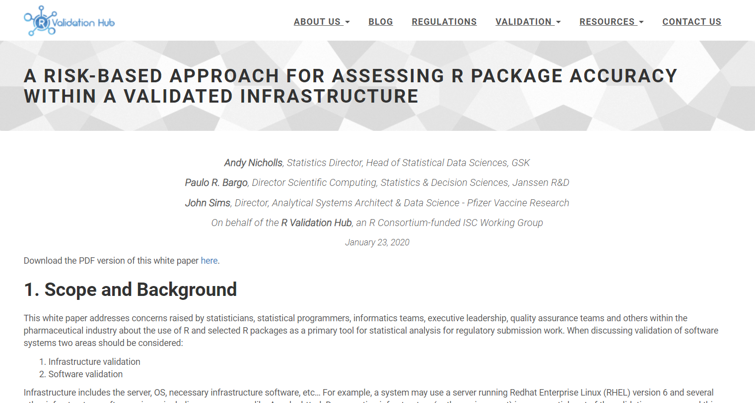

Slide 18
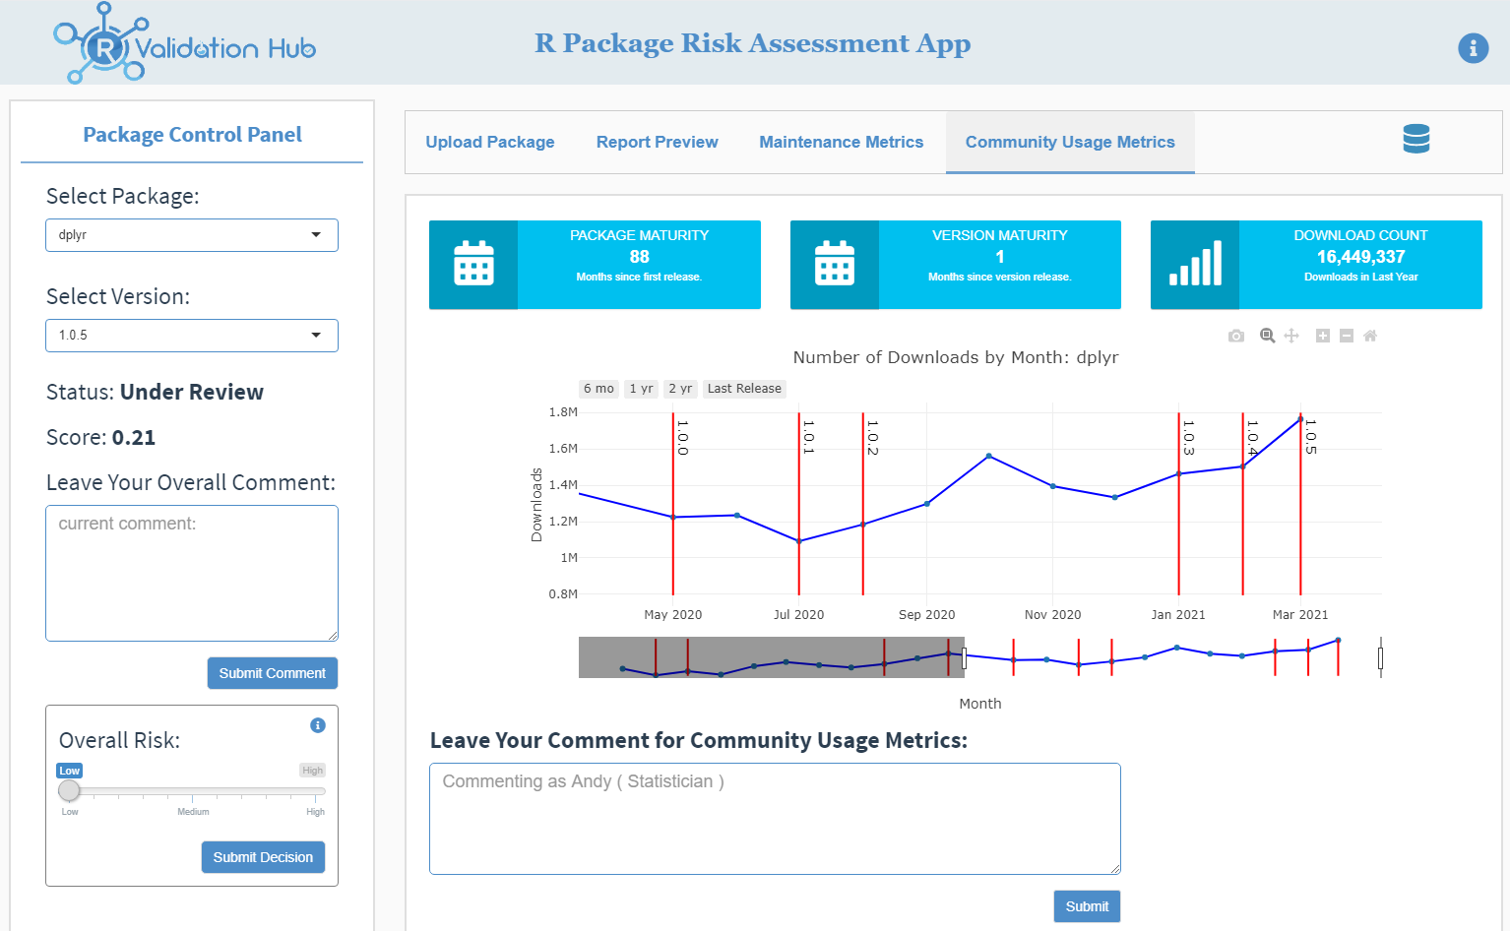

Slide 19

Challenge 2: Responding to Risk
ICH: “Appropriate software testing procedures”
Notes:
Image: https://www.denverpost.com/2019/06/08/dodgeball-tool-of-oppression-dehumanizing/
We can’t avoid risk completely. We must do our best to mitigate it.
Focus effort on the biggest risk areas.

Slide 20


Challenge 2a: An Appropriate Comparison
vs

Slide 21
Summary
Definitely possible
“The computer software used for data management and statistical analysis should be reliable, and documentation of appropriate software testing procedures should be available”
ICH E9
More of a challenge!
Thank You

Slide 22
Acknowledgements
R Validation Hub
The PSI AIMS SIG
Shutterstock

Slide 23
Further Reading
R
R Validation Hub
R: Regulatory Compliance and Validation Issues A Guidance Document for the Use of R in Regulated Clinical Trial Environments
tidyverse, tidymodels, r-lib, and gt R packages: Regulatory Compliance and Validation Issues
ICH
E9
FDA
FDA Statistical Software Clarifying Statement
21 CFR Part 11
Guidance for Industry Part 11, Electronic Records; Electronic Signatures — Scope and Application
Glossary of Computer System Software Development Terminology
General Principles of Software Validation; Final Guidance for Industry and FDA Staff
EMA
Notice to sponsors on validation and qualification of computerised systems used in clinical trials
Q&A: Good clinical practice (GCP)

